Slide 1

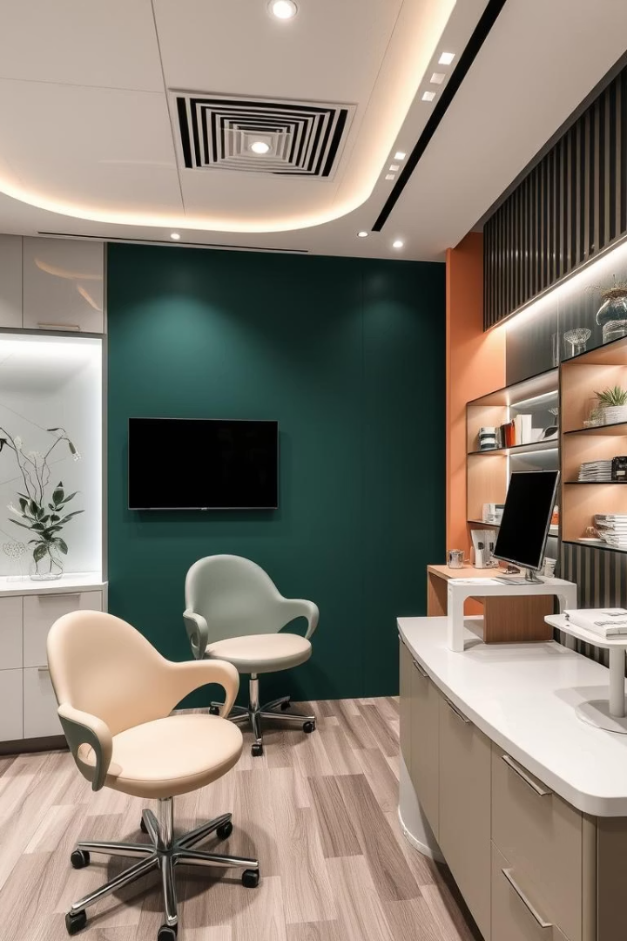
OPTIMIZING PRICING, APPOINTMENTS, AND INVENTORY IN AN EYE CLINIC
Shriyanshi Parashari
22f3001012
IITM Online BS Degree Program, Indian Institute of Technology, Madras
1

Slide 2
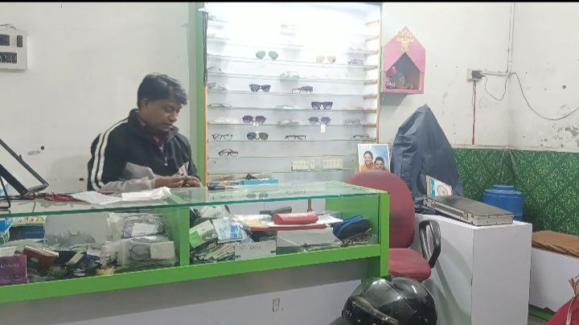
Organization Background
City Optics And Eye Care Centre
Location: Near Women District Hospital, Budaun, Uttar Pradesh
Services Offered:
  Comprehensive eye diagnostics and vision check-ups
  Prescription of glasses tailored to patient needs
  Retail sales of frames and lenses, including a wide selection of product categories
Reputation:
City Optics and Eye Care Centre has established itself as a trusted provider of quality eye care in the local community, known for its personalized service and attention to patient satisfaction
2

Slide 3
Problem Statement
Pricing Pressure from Competitors
  City Optics charges 13% higher for lenses than local competitors (₹425 vs ₹375.67), making it difficult to retain price-sensitive customers and compete with chain stores and online retailers.
Appointment Scheduling Inefficiencies
  The clinic faces a 24.5% cancellation rate, with 23.5% of appointments cancelled due to overcrowding and long wait times, resulting in lost revenue and inefficient resource utilization.
Inventory Management Issues
  ₹350,379 is tied up in inventory, with significant overstocking in slow-moving categories such as sheet frames (400 units) and glass lenses (500 units), leading to capital inefficiency and risk of obsolescence.
Summary Table
Problem Area | Key Issue | Quantitative Impact
Pricing | Lens prices 13% higher than competitors | ₹425 vs ₹375.67
Appointments | High cancellation rate due to overcrowding | 24.5% cancellations (23.5% due to crowding)
Inventory | Excess capital tied in overstocked, slow-moving stock | ₹350,379 in inventory; turnover <0.4x/month
3

Slide 4
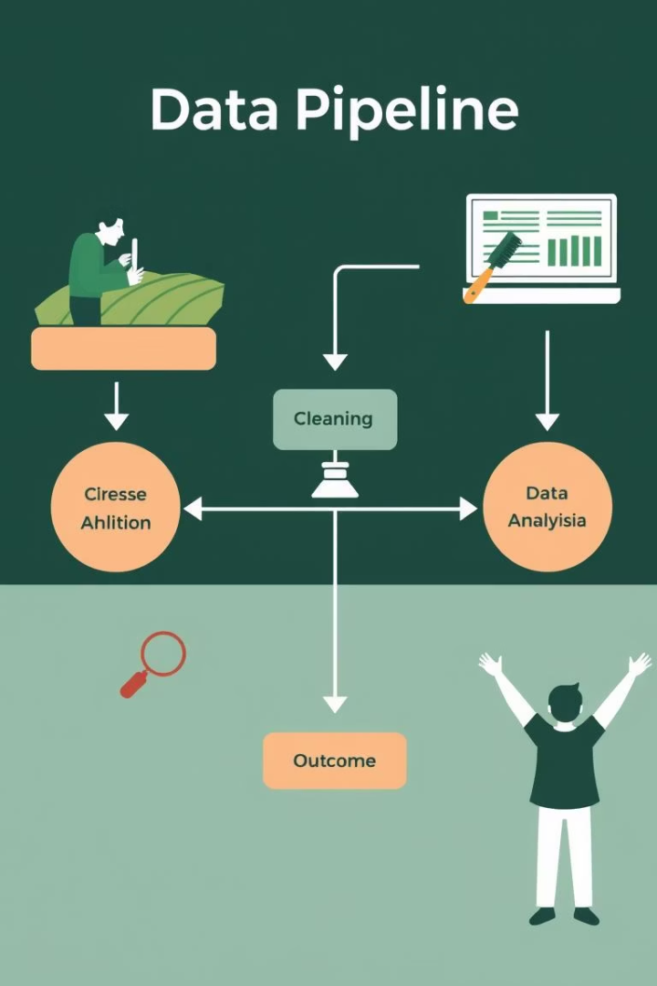
Data Collection and Methodology
Data Sources
Patient Records:
  306 records covering appointments, demographics, prescriptions, cancellations, and purchases.
Competitor Analysis:
  Pricing and service data from 15 local optical shops.
Inventory & Sales Audit:
  Complete audit of stock and transaction-level sales data.
Methodological Workflow
Data Collection:
  Gathered primary data from the clinic, competitors, and inventory systems through records, direct observation, and staff interviews123.
Data Cleaning:
  Standardized formats, handled missing values, removed duplicates, and validated entries for accuracy12.
Analysis:
  Applied descriptive statistics, correlation analysis, and visualization techniques (bar charts, pie charts, heat maps) to extract actionable insights123.
Outcome:
  Data-driven recommendations for pricing, appointment scheduling, and inventory management
4

Slide 5
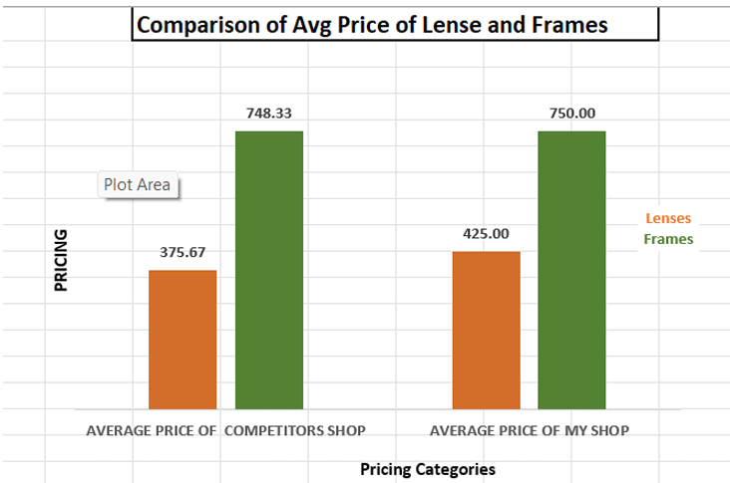
Results – Pricing Analysis
Key Findings
13.1% Price Premium on Lenses:
City Optics charges ₹425 for lenses, which is 13.1% higher than the local competitor average of ₹375.67.
For frames, pricing is nearly identical (₹750 at City Optics vs ₹748.33 at competitors), indicating minimal difference and competitive positioning in this category.
Interpretation:
The lens price premium places City Optics at a disadvantage in a price-sensitive market, likely contributing to customer attrition.
Bundling opportunities exist, as 87% of frame buyers also purchase lenses, making bundled discounts a strategic option.
Product Category | City Optics Price | Competitor Avg. Price | Price Premium
Lenses | ₹425 | ₹375.67 | +13.1%
Frames | ₹750 | ₹748.33 | +0.2%
5

Slide 6
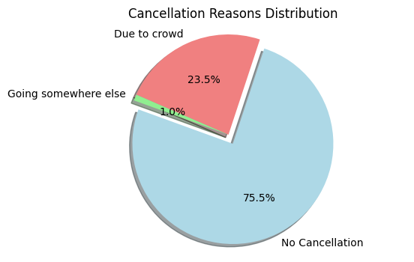
Results – Appointment Analysis
Cancelled | Cancellation Reason | Count of Cancellation Reason
No | None | 231
No Total |  | 231
Yes | Due to crowd | 72
Yes | Going somewhere else | 3
Yes Total |  | 75
Grand Total |  | 306
Cancellation Breakdown
75.5% of appointments were kept (no cancellation)
23.5% cancelled due to crowding/overcrowding
1% cancelled to go elsewhere
Peak Cancellation Times
Highest cancellation rate: 5:00–6:00 PM on weekdays (32% cancellation rate)
Lowest cancellation rates: Weekend mornings (as low as 8%)
Key Insights
Overcrowding and long wait times are the main causes of cancellations, not competition.
Peak-hour congestion (especially weekday evenings) is the critical period for intervention.
Reducing wait times and redistributing appointment slots can significantly improve patient retention and clinic efficiency.
Cancelled | Reason | Count
No | None | 231
Yes | Due to crowd | 72
Yes | Going somewhere else | 3
Total |  | 306
6

Slide 7
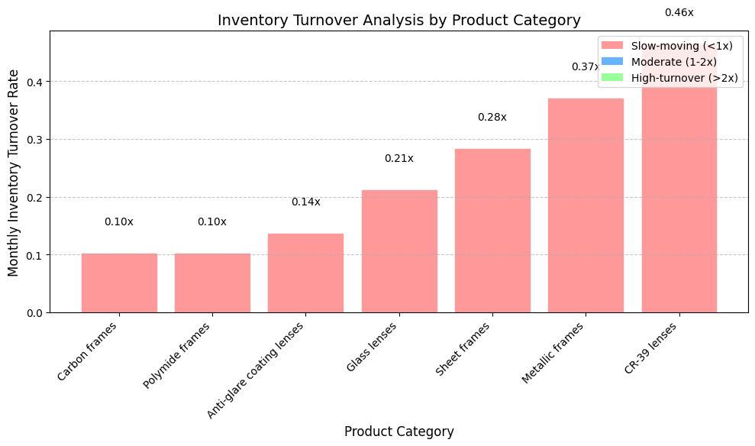
Results – Inventory Analysis
Product | Quantity | Purchase Rate | Total Cost | Discount % | Amount
Metallic (Frames) | 70 | 700 | 49000 | 10.71% | 43752.1
Sheet (Frames) | 400 | 400 | 160000 | 15.20% | 135680
Carbon (Frames) | 20 | 1400 | 28000 | 7.60% | 25872
Polymide (Frames) | 40 | 500 | 20000 | 10% | 18000
Glass (Lenses) | 500 | 150 | 75000 | 17.33% | 62002.5
Fibre C-39 (Lenses) | 100 | 400 | 40000 | 12.40% | 35040
Blue cut (Lenses) | 20 | 600 | 12000 | 8.64% | 10963.2
Anti Glayor Cotting (Lenses) | 10 | 700 | 7000 | 7.90% | 6447
Eye Drops | 500 | 30 | 15000 | 15.85% | 12622.5
 |  |  |  |  | 350379.3
Inventory Value
₹350,379 total inventory investment is currently tied up in stock at City Optics and Eye Care Centre.
Stock Issues
Significant overstocking in:
  Sheet frames: 400 units in stock
  Glass lenses: 500 units in stock
These slow-moving categories are tying up working capital and increasing the risk of product obsolescence.
Key Insights
Over 43% of inventory capital is locked in slow-moving stock, limiting the clinic’s ability to invest in high-demand products or new offerings1.
Overstocking in sheet frames and glass lenses is the most acute, with turnover rates indicating it would take over three months to clear current stock at existing sales rates.
Metallic frames, while performing better, still fall short of optimal turnover, suggesting a need for more dynamic inventory management.
Actionable Takeaway
Immediate reduction of order quantities for slow-moving categories and implementation of a Just-in-Time (JIT) inventory system are recommended to free up capital and reduce holding costs123.
Regular monitoring and adjustment of inventory based on real-time sales data will help prevent future overstocking and improve overall operational efficiency.
7

Slide 8

Recommendations – Pricing & Appointments
Dynamic Pricing Strategy
Reduce lens prices by 8–10%
  Close the competitive gap and attract more price-sensitive customers.
Implement three-tier bundling (12–18% discounts)
  Offer bundled packages (e.g., Economy, Standard, Premium) combining frames, lenses, and coatings to increase average order value.
Create a seasonal promotion calendar
  Plan targeted offers during festivals and health awareness weeks to boost periodic sales.
Appointment Optimization
Restructure time slots
  Allocate more staff and appointment slots during peak hours (especially 5:00–6:00 PM) to reduce crowding and cancellations.
Implement SMS reminder system with wait time updates
  Send automated reminders and real-time updates to patients, reducing no-shows and improving satisfaction.
Deploy queue management system with visual displays
  Use digital displays in the clinic to show live queue status and estimated wait times, enhancing transparency and patient experience.
8

Slide 9

Recommendations – Inventory & Implementation Plan
Just-In-Time (JIT) Inventory System
Product-specific stocking policies
  Prioritize high-turnover items (e.g., metallic frames: 0.37x/month) and reduce orders for slow-moving stock (sheet frames: 0.28x/month).
Digital inventory tracking
  Implement barcode scanning for real-time stock updates and automated reorder alerts.
Predictive ordering
  Use historical sales data and seasonal trends (e.g., higher lens sales during monsoon) to optimize stock levels.
9

Slide 10

Projected Outcomes & Conclusion
Expected Improvements
20–25% reduction in appointment cancellations
₹75,000 decrease in capital tied up in inventory
15–20% increase in lens sales volume
Performance Metrics (Targets)
Metric | Current Value | Target Value
Cancellation Rate | 24.5% | < 15%
Inventory Turnover | 0.21–0.37x/month | 1.8x/month
Patient Satisfaction | 3.7/5 | 4.2/5
Visual: Before/After Comparison
Metric | Before (Current) | After (Projected) | Improvement Indicator
Cancellation Rate | 24.5% | < 15% | 🔻 Significant decrease
Inventory Capital | ₹350,379 | ₹275,000 | 💸 More cash available
Lens Sales Volume | Baseline | +15–20% | 📈 Higher sales
Patient Satisfaction | 3.7/5 | 4.2/5 | 😀 Happier patients
10

